Slide 1
Progressing Toward Proficiency
Describe a circus as if you were talking to an alien according to the level of proficiency your group has been given.
This could be done on any topic, seafair, family, school day.

Slide 2
Proficiency levels free from The Creative Language Classroom

Slide 3
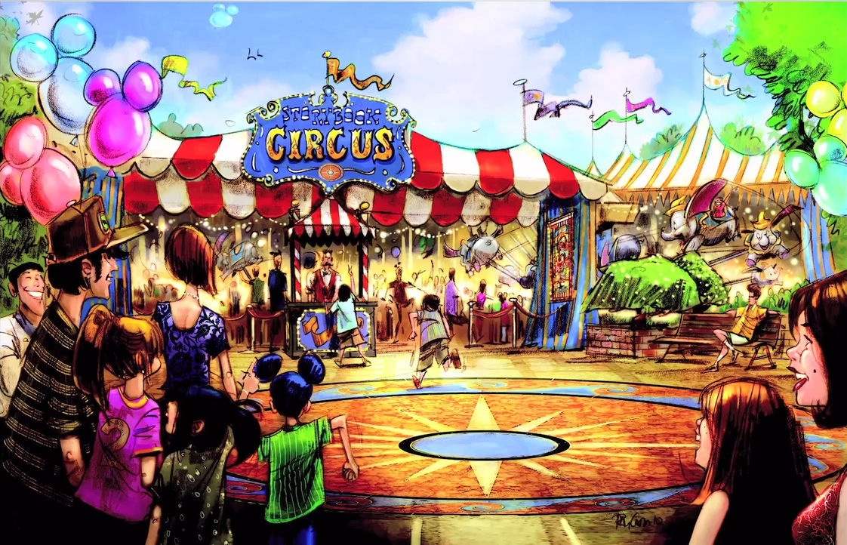

Slide 8
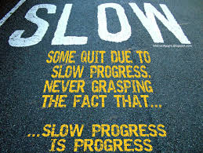

Slide 9
Explain Seafair to someone who has never been to Seattle!

Slide 18
How do you level up?

