Slide 1
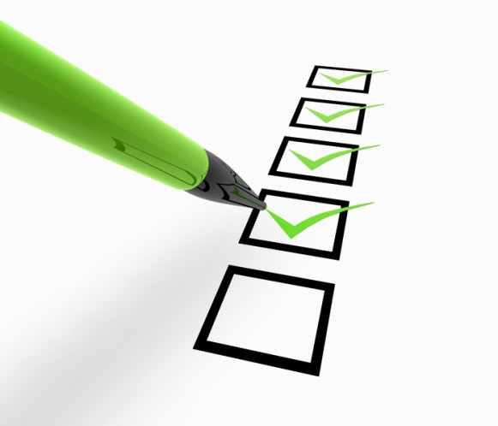
Accuracy checklist
Does it make sense?
Have you checked your spelling?
Have you used correct punctuation?
Have you used the accents in the right places?
Have you put an –s on the end of any plurals (if they need them)?
Have you put an –e on the feminine adjectives?
Openers, Connectives & Extenders
These are great words to use to help you to extend your writing.
et and
mais but
avec with
sans without
aussi also
cependant however
parce que c’est … because it’s
car c’est… as it’s
donc so
si if
bien que although
où where
ou or
par contre on the other hand
après after
d’abord firstly
enfin lastly
puis then
encore again
ensemble together
ensuite then
Common Spelling Mistakes
beaucoup la soeur
la famille confortable
intéressant juillet
mercredi au revoir
aide-mémoire d’alphabétisation en franÇais
Punctuation rules!
Use a capital letter at the beginning of every sentence.
Use a full stop at the end of a statement sentence.
Use a question mark at the end of a question.
Use an exclamation mark at the end of a sentence if you want to make it show surprise or give a command.
Weird and wonderful things about writing in French
You only use a capital letter at the start of a sentence and for proper nouns. Days of the week, months of the year and subject names don’t have capital letters in French.
French speech marks look like this: « speech »
You use a comma instead of a decimal point when writing a decimal number: in English, you’d write 3.5 – in French you’d write 3,5 instead.

Slide 2
Verb – infinitive | In the past | In the present | In the future
Avoir To have | J’ai eu / J’avais I had / I used to have | J’ai I have | Je vais avoir / J’aurai I am going to have / I will have
Être To be | J’étais I was | Je suis I am | Je vais être / Je serai I am going to be / I will be
Faire to do | J’ai fait / Je faisais I did / I was doing | Je fais I do / I make | Je vais faire / Je ferai I am going to do / I will do
Aller To go | Je suis allé(e) / J’allais I went / I was going | Je vais I go | Je vais aller / J’irai I am going to go / I will go
Jouer To play | J’ai joué / Je jouais I played / I was playing | Je joue I play | Je vais jouer / Je jouerai I am going to play / I will play
Manger To eat | J’ai mangé / Je mangeais I ate / I was eating | Je mange I eat | Je vais manger / Je mangerai I am going to eat / I will eat
Opinions - sentence starters
J’adore … I love…
J’aime … I like …
J’aime bien … I really like …
Je n’aime pas… I don’t like …
Je déteste … I hate …
Je pense que … I think that …
Positive adjectives
parce que c’est… because it’s …
agréable pleasant
amusant fun
chouette great
drôle funny
époustouflant mind-blowing
excellent excellent
extraordinaire extraordinary
facile easy
fantastique fantastic
formidable tremendous
intéressant interesting
merveilleux marvellous
parfait perfect
passionnant exceiting
pratique practical
sensass sensational
splendide splendid
sympa nice
C’est : it is
C’était: it was
Ce sera: it will be
Negative adjectives
parce que c’est… because it’s …
affreux awful
bête stupid
casse-pieds a waste of time
désagréable unpleasant
difficile difficult
embêtant annoying
ennuyeux boring
barbant really boring
épouvantable dreadful
faible weak
moche ugly
nul rubbish
ridicule ridiculous
stupide stupid
Time indicators
Past:
Hier - yesterday
Le weekend dernier - last weekend
La semaine dernier – last week
Present:
Aujourd’hui – today
Normalement – usually
Le lundi – On a Monday
Future:
Demain – tomorrow
Le weekend prochain – next weekend
La semaine prochaine – next week

